Slide 1
Applying CBR Retrieval and Rule-Based Heuristics to Improve Alpha-Beta Search in Chess
Josep Han, Rowan Lavelle, Zach Wilkerson

Slide 2
Why Chess? What Other Work Exists?
High branching factor
Complex emergent game states
Lends itself to rule-based and/or case-based approaches
Deep Blue (1997) Campbell et al., “Deep Blue”. Artificial Intelligence; 2002
Stockfish (2008, maintained thru present) Grunke, Paul, “Chess, Artificial Intelligence, and Epistemic Opacity”. Információs Társadalom; 2019
AlphaZero (2017) Silver et al., “Mastering Chess and Shogi by Self-Play with a General Reinforcement Learning Algorithm”. CoRR; 2017
20^{n} est. branching, n = 40:
1.10 * 10⁵² moves

Slide 3
Background:
The MiniMax Algorithm
Alpha-Beta pruning for MiniMax
Heuristics

Slide 4
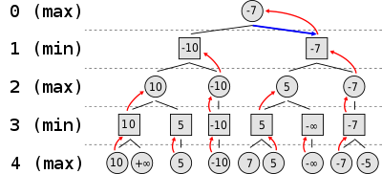
MiniMax Algorithm

Slide 5
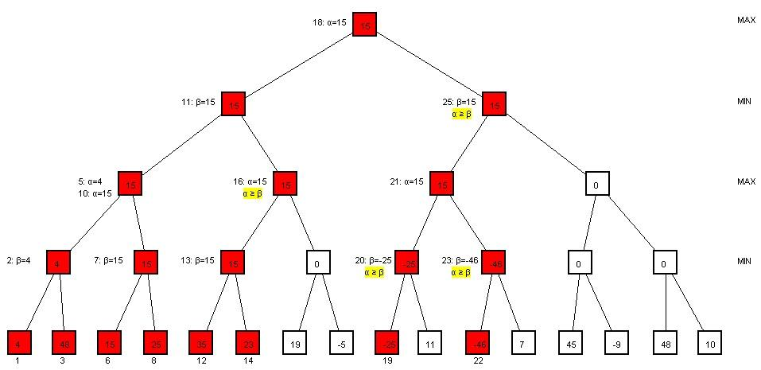
Alpha-Beta Pruning for MiniMax
Alpha: update on max, Increase
Beta: update on min, Decrease
Alpha >= Beta: Prune

Slide 6
Heuristic
Material Value: what each piece on the board is worth
Piece Positioning: how good is the location of each piece on the board (Piece square tables)
Threats: How many enemy pieces are threatened and how many of our pieces are being threatened
H = C_{mat} * H_{mat} + C_{pos} * H_{pos} + C_{threat} * H_{threat}

Slide 7
Learning the weights
Genetic Algorithm: Crossover and mutation
10 generations of players
5 agents play a round robin (25 games)
Top 3 agents are selected to breed (6 children)
5 of the children are randomly selected to be the new generations agents
Weights are chosen as the top performer of the last generation
*** Due to having to play 250 games, and each game taking between 5 and 10 minutes…. Results are not in yet for optimal weights

Slide 8
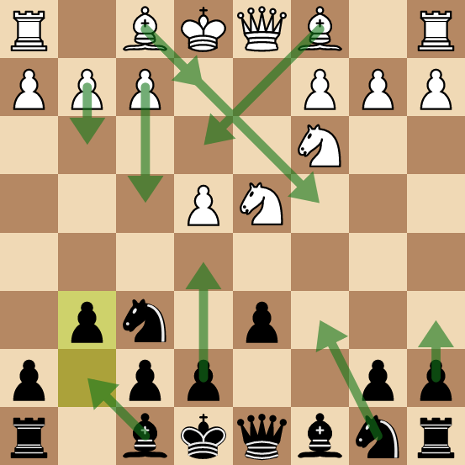
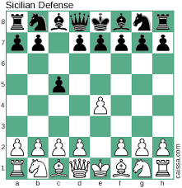
Case-Based retrieval as an AI for opening game

Slide 9
CB Opening AI
Similarity metric: Hamming distance
Retrieve all similar cases with a hamming distance between 0 and 2 from the closest board
Sort cases in decreasing order by number of moves the opening contains
Attempt to play the next sequence of moves, if not valid moves are found switch to Pruning AI

Slide 10
OpenAI results
Sets the board up very well for future play by the pruning AI
Open vs Open: 13 moves played by AI
Open vs Random Player: 5.8 moves by AI on average
Open vs Base Player: 12 moves played by AI
*** Open vs Open and Open vs Base are not averages since opening game is deterministic (the opening AI plays Queen’s pawn if its making first move, and Queen’s pawn is countered by Sicilian defense) Base player will make the same move given a board, and since there is no randomness within the openAI, the same game is played once the Opening AI chooses Queen’s pawn.

Slide 11
Key to Success = Minimize Search Costs
Dynamic programming for repeated states (e.g., “transposed openings”)
Prune the search tree
Alpha-beta pruning based on heuristic score
Rule-based pruning based on positional information (novel approach)
Each successful prune removes
b^{d-x} heuristic calls

Slide 12
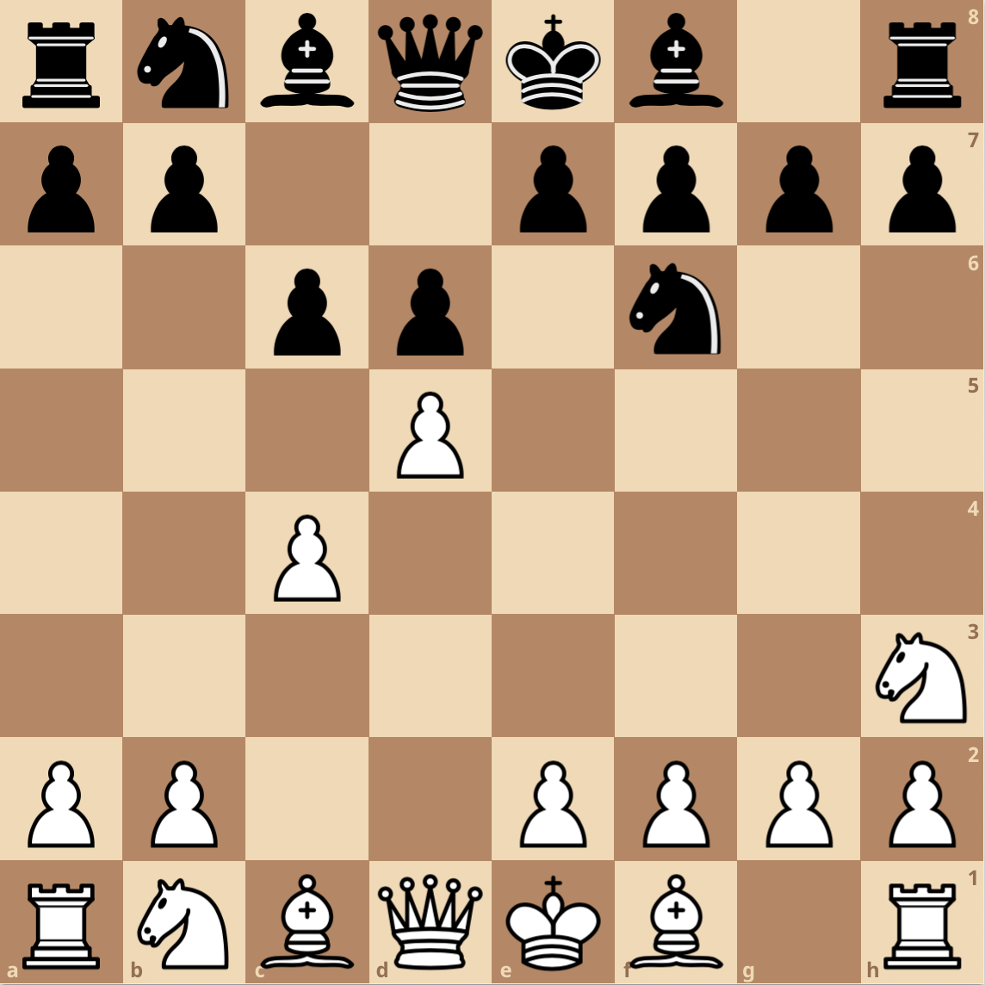
Positional Considerations
Idea:
c6 pawn threatened
Good:
cxd5 (exchange)
c5 (avoid capture)
Bad:
Nxd5 (bad exchange)
Idea:
Pressure the opposing king
Good:
Qa5+?
Bg4?
Bad:
Qa5+?
Bg4?
Idea:
More piece activity
Good:
Nd7 (strong defense)
Bf5 (more active)
Bad:
Rg8 (no progress)
Idea:
Create threats
Good:
Qa5+ (check)
Bxh3 (exchange)
Bad:
Be6 (bad exchange)
Pruning must be certain
Figure constructed using lichess.com/editor
Notes:
Uncertain ideas:
Pressure the opposing king
Control important regions of the board
(Over) Protection and X-rays

Slide 13
Pruning Model Evolution
Too many things to match/adapt - no time benefit
Case-based Reasoner Case matching based on rules adaptations for specific exceptions
Hierarchical rule-based model Rule tiers to describe situations and specific options
Too inflexible - often too much pruning
Broad rule-based model Broad rule applications combinations add specificity

Slide 14
Model Highlights and Testing Plan
Max pruning conditions: consider moves that...
Save your threatened pieces (*maybe not interventions*)
Improve your piece activity
Capture opposing pieces
Don’t trap you in losing exchanges
Min pruning conditions (necessarily simplified)
No losing exchanges
Anticipated tests (initial results look promising for speed)
Temporal comparison against simple heuristic
Playing strength against simple heuristic (does it prune away “red herrings”?)

Slide 15
Designing the Evaluation Comparison
Access Lichess database that includes 121,332 games played on the server
Pick out 3 games depending on skill level
1 game between 1000-1500 average Elo scores (low level)
1 game between 1500-1900 (mid level)
1 game above 1900 (high level)
For every move for each game, compare the evaluation metric between regular Alpha-beta search (BasePlayer) with the modified Rule based Player (CBR Player)
In addition, compare the evaluation time

Slide 16
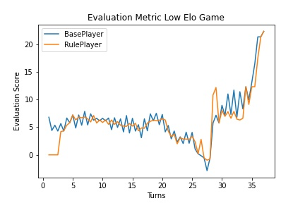
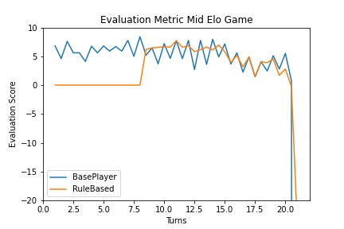
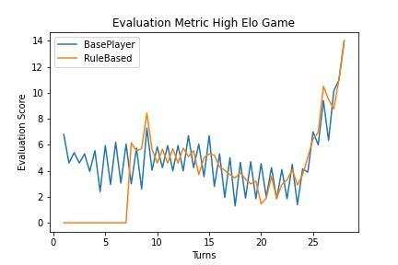
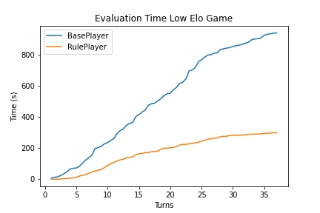
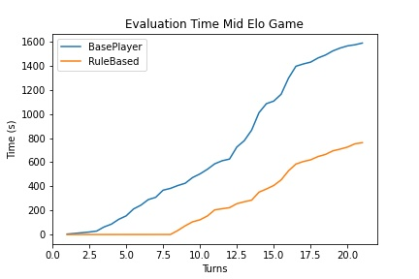
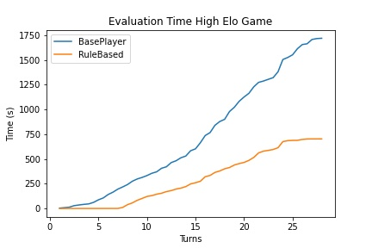
CBR Player in Practice

Slide 17
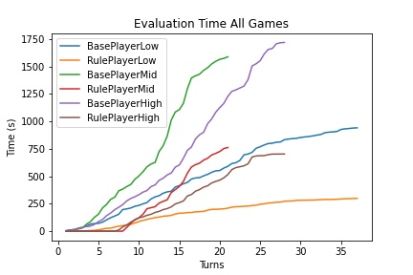

Slide 18
Limitations and Future Improvements
Doesn’t address the biggest factor in the runtime
Original runtime: O(b^{d}) , where b = branching factor , d = depth
Our implementation: O(b^{d}) = O((b-n)^{d}) , n = number of states deleted before exploring
I.e. increasing depth by 1 dwarfs the pruning optimization made by our algorithm
Limitations of Python
No multithreading support
Time consuming to evaluate games
Hard to compare with other engines (e.g. Stockfish) which are more optimized in running calculations

